Slide 1
Module 10

Slide 2


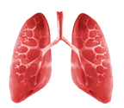
EXCHANGE OF GASES IN ANIMALS
Different animals have different organs for respiration. For eg.
Now let us study Breathing i.e., exchange of gases in detail:
First we will study exchange of gases in animals:
Aquatic animals respire through
Amphibian animals respire through
Terrestrial animals respire through
GILLS
SKIN
LUNGS

Slide 3
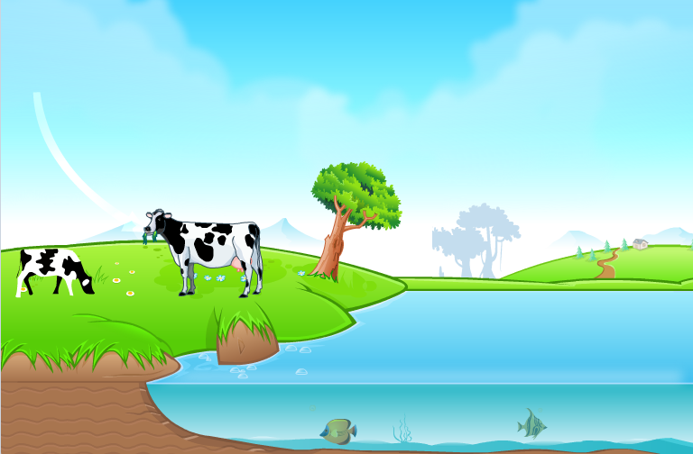






First we will learn exchange of gases in Aquatic animals.
So the amount of oxygen available is much lesser than air.
Hence the rate of breathing is faster in aquatic animals.
Aquatic animals use oxygen dissolved in water.
The solubility of oxygen in water is much lower.
Speed of breathing.
O₂
O₂
O₂
O₂
O₂
O₂
O₂
O₂
O₂
O₂
O₂
O₂
O₂
O₂
O₂
O₂
O₂
O₂
O₂
O₂
O₂
O₂
O₂
O₂
O₂
O₂
O₂
O₂
O₂
O₂
O₂

Slide 4
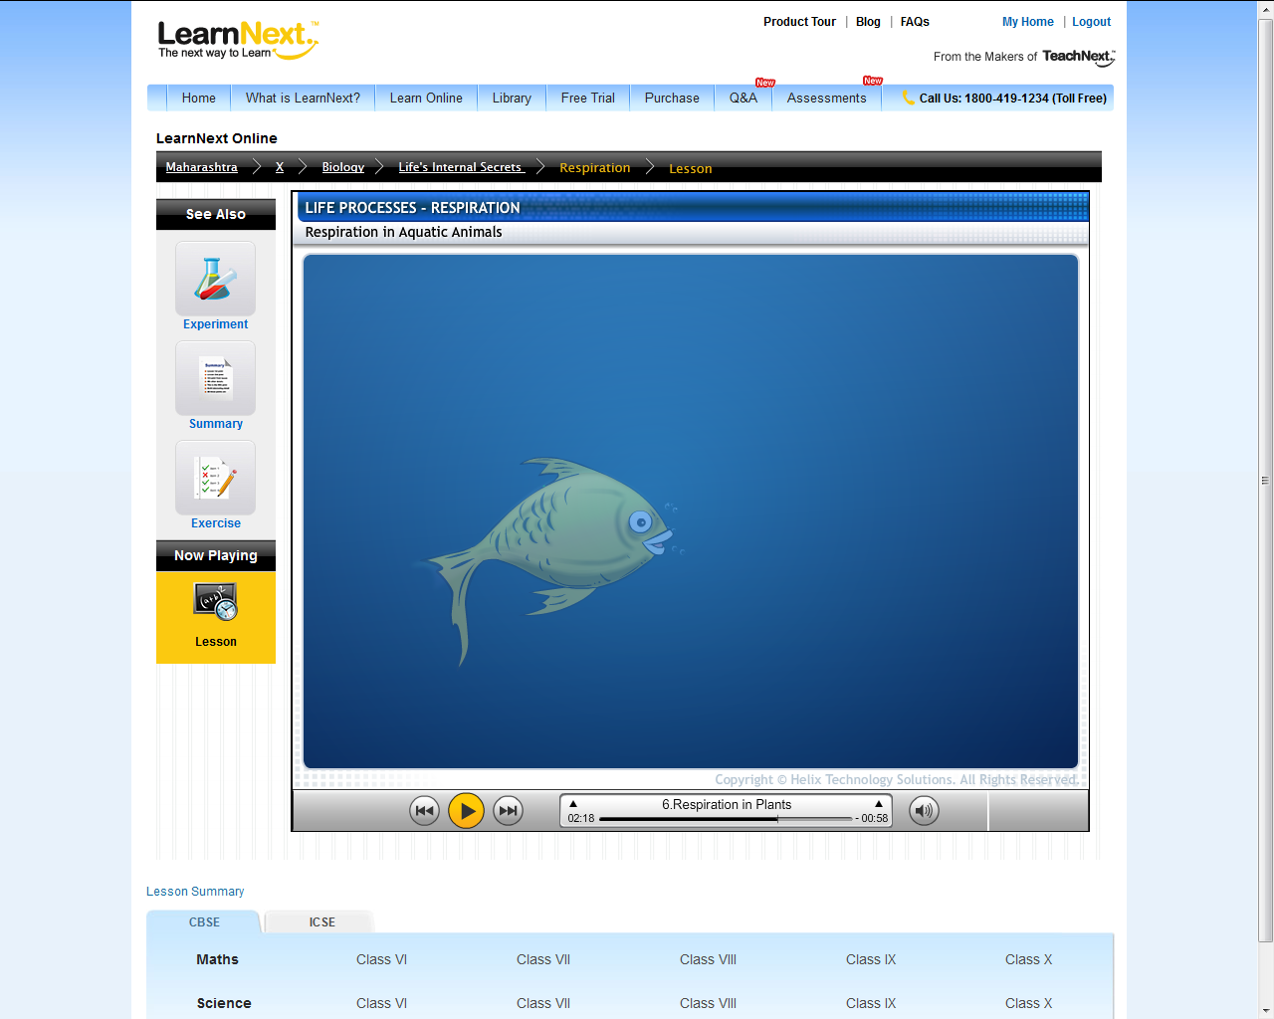
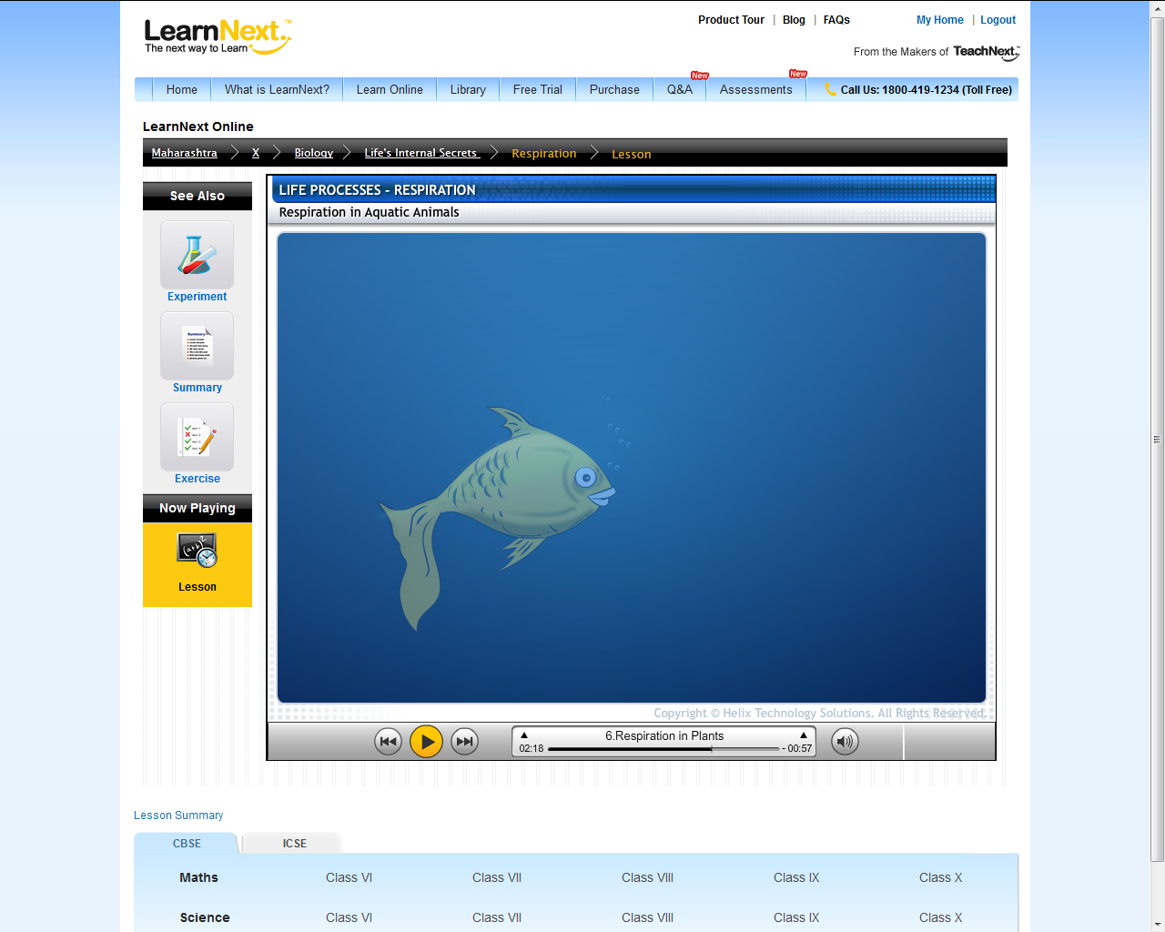

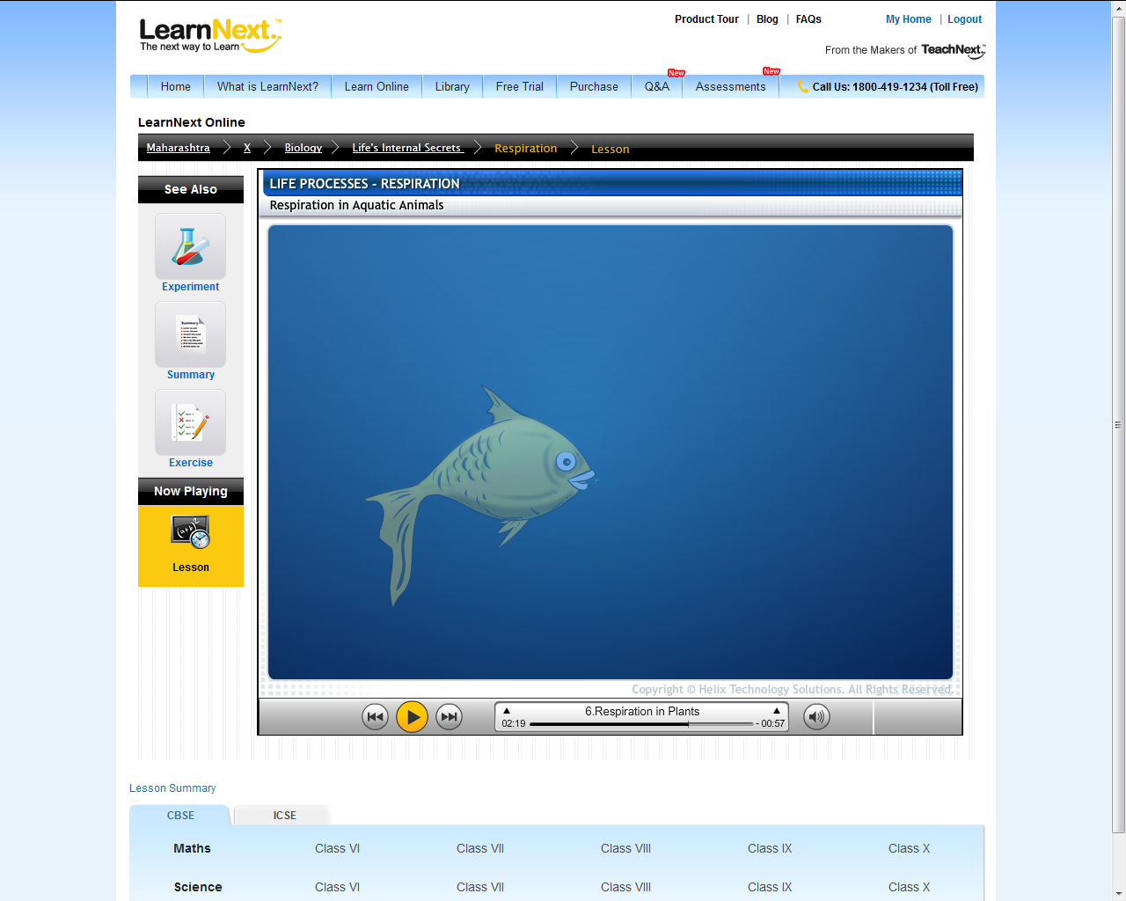

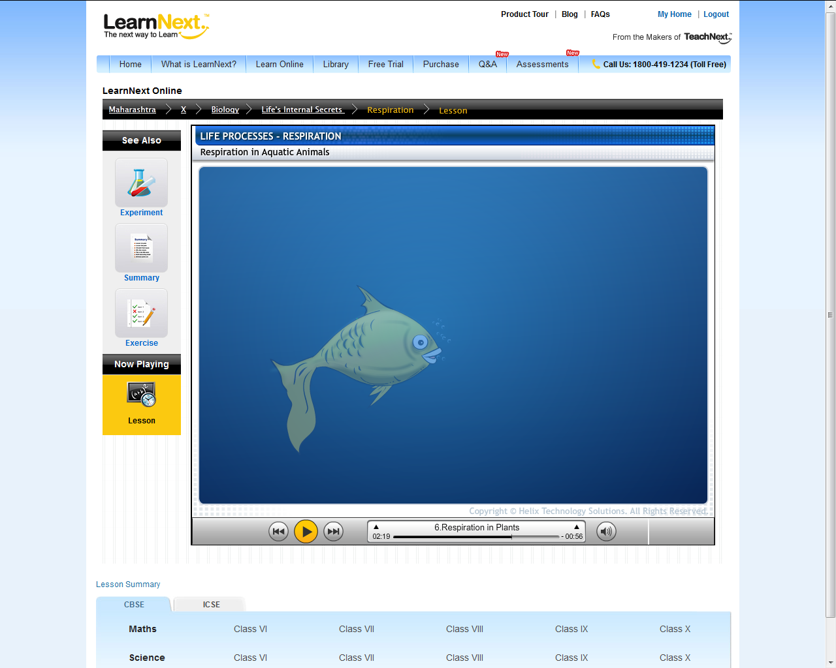




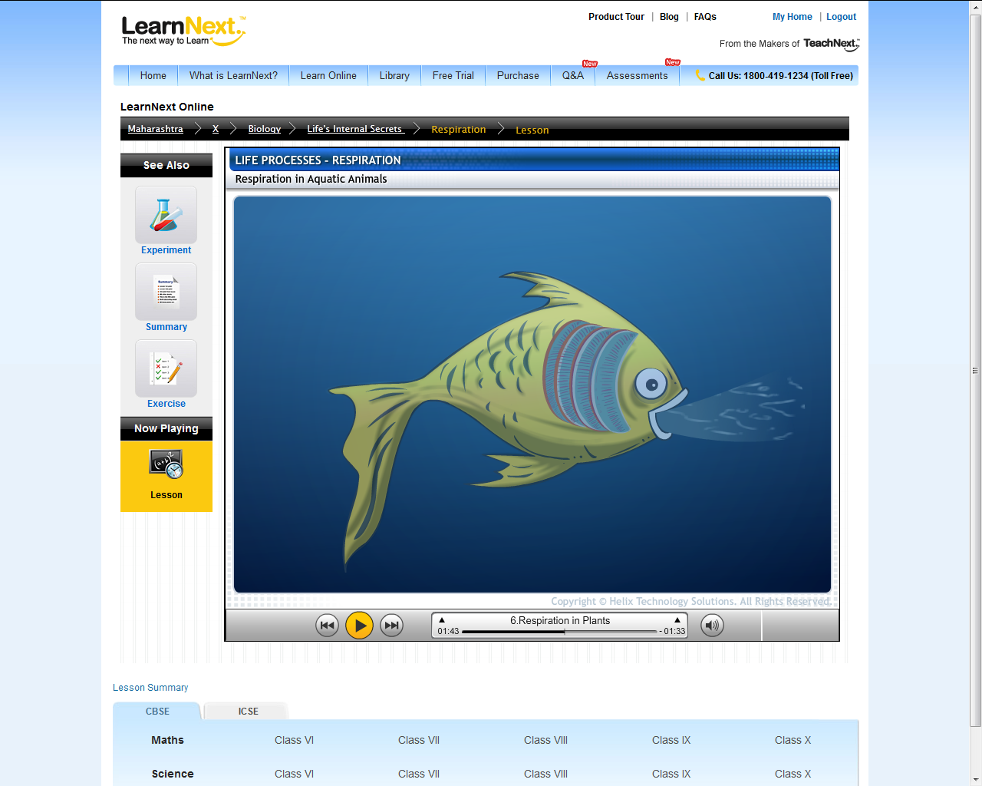
Through the gills oxygen from the water enters the blood and carbon dioxide from the blood enters the water.
Fish take in oxygen rich water through the mouth and release it over the gills.
This water containing carbon dioxide then leaves out from the gills.
This process takes place through diffusion.
The concentration of carbon dioxide is more in blood as compare to water. So carbon dioxide enters the water.
The concentration of oxygen is more in water as compare to blood. So oxygen enters the blood.
Movement from high concentration
to low concentration
Gills
CO₂
O₂
O₂

Slide 5
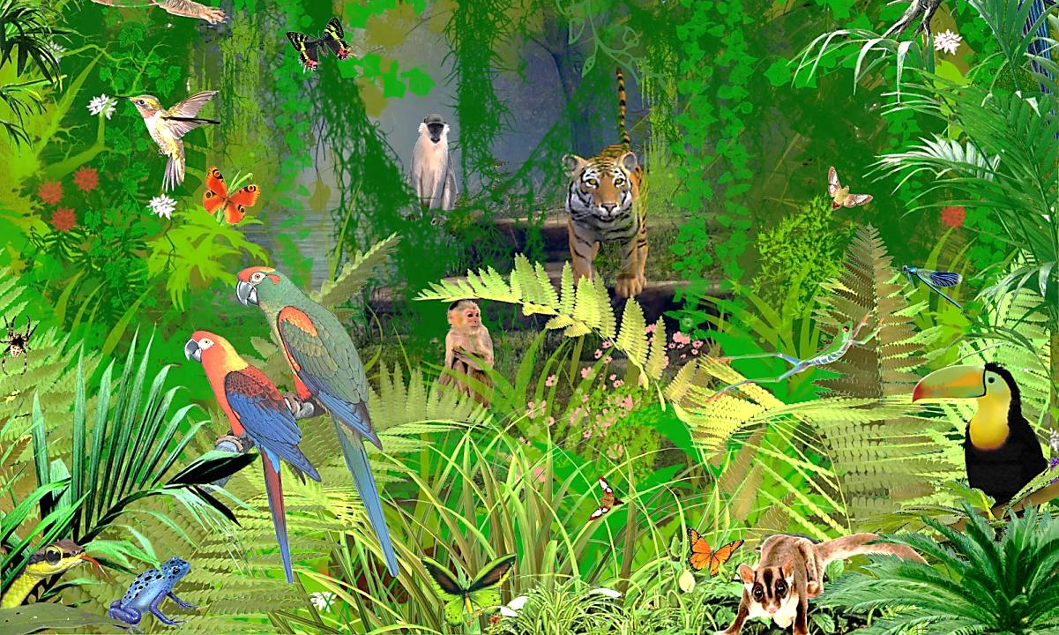
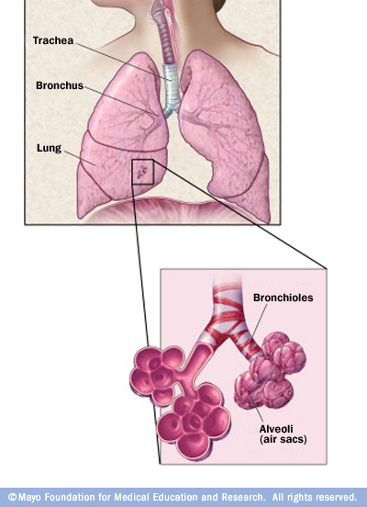
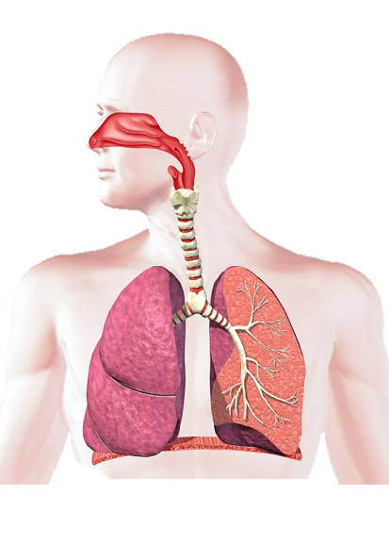
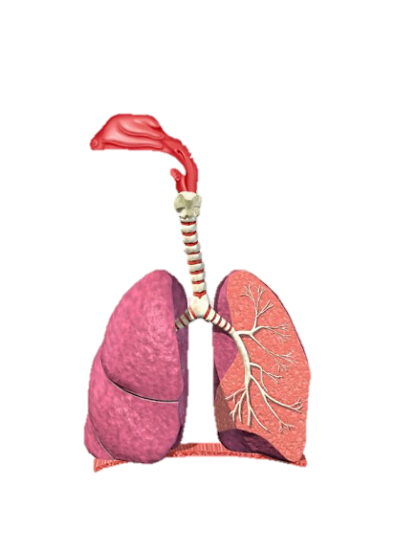

These organs have special structure that increase the surface area so that more exchange of gases takes place.
The respiratory organs in different animals are different but the process of diffusion is common.
But these structures are delicate, so they are placed within the body.
Exchange of gases in Terrestrial animals.
Terrestrial animals take up oxygen from air.
From high concentration
to low concentration
O₂
O₂
O₂
O₂
O₂
CO₂

Slide 6
Thank You

